Slide 1
UNDERSTAND PRIVACY, COMPLIANCE, AND DATA PROTECTION STANDARDS IN AZURE

Slide 2
Executive summary
Purpose
Layout
Style
The executive summary should be a brief, stand-alone version of a document that focuses on the most important messages, meant to be read rather than presented.
Do not include any content that is not in the body of the document.
Use the columns in this layout to organize the content.
If you need more than 3 columns, use two rows or add a second page.
Be brief. Write the shortest, simplest sentences possible.
Favor active over passive verbs.
Use plain words and the client’s terminology, not consulting jargon.
Source: …

Slide 3
Agenda
Microsoft Privacy Statement
TRUST CENTER
SERVICE TRUST PORTAL
COMPLIANCE MANAGER
AZURE GOVERNMENT
AZURE GERMANY

Slide 4
The Microsoft privacy statement is a comprehensive statement from Microsoft that outlines the following as it relates to handling data and your personal information.
Personal data Microsoft collects
How Microsoft uses personal data
Reasons Microsoft shares personal data
How to access and control your personal data collected by Microsoft
How Microsoft uses cookies and similar technologies
What organizations providing Microsoft software to you can do with your data
What data is shared when you use a Microsoft Account with a third-party
Specifics about how Microsoft secures data, where it’s processed, and retention policies
Microsoft links to the privacy statement in all official communications, and you can access the privacy statement online at: https://aka.ms/privacystatement.

Slide 5
Agenda
Microsoft Privacy Statement
TRUST CENTER
SERVICE TRUST PORTAL
COMPLIANCE MANAGER
AZURE GOVERNMENT
AZURE GERMANY

Slide 6
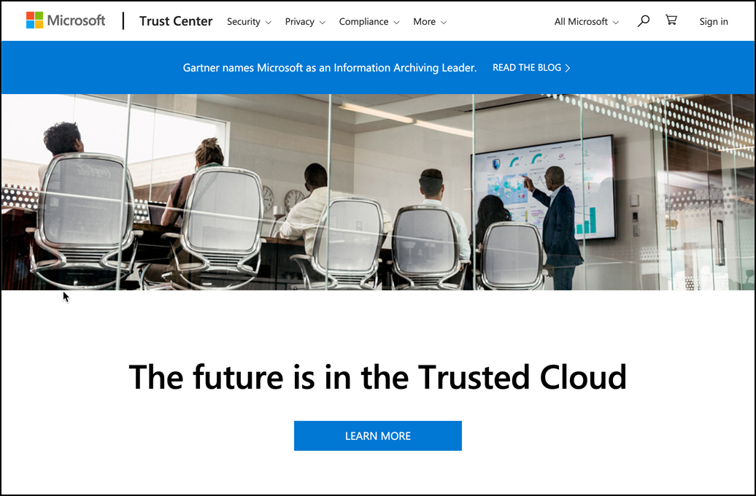
TRUST CENTER
The Trust Center is a web portal where you can learn all about Microsoft’s approach to security, privacy, and compliance. You can access Trust Center by browsing to: https://www.microsoft.com/en-us/trustcenter/default.aspx

Slide 7
Agenda
Microsoft Privacy Statement
TRUST CENTER
SERVICE TRUST PORTAL
COMPLIANCE MANAGER
AZURE GOVERNMENT
AZURE GERMANY

Slide 8
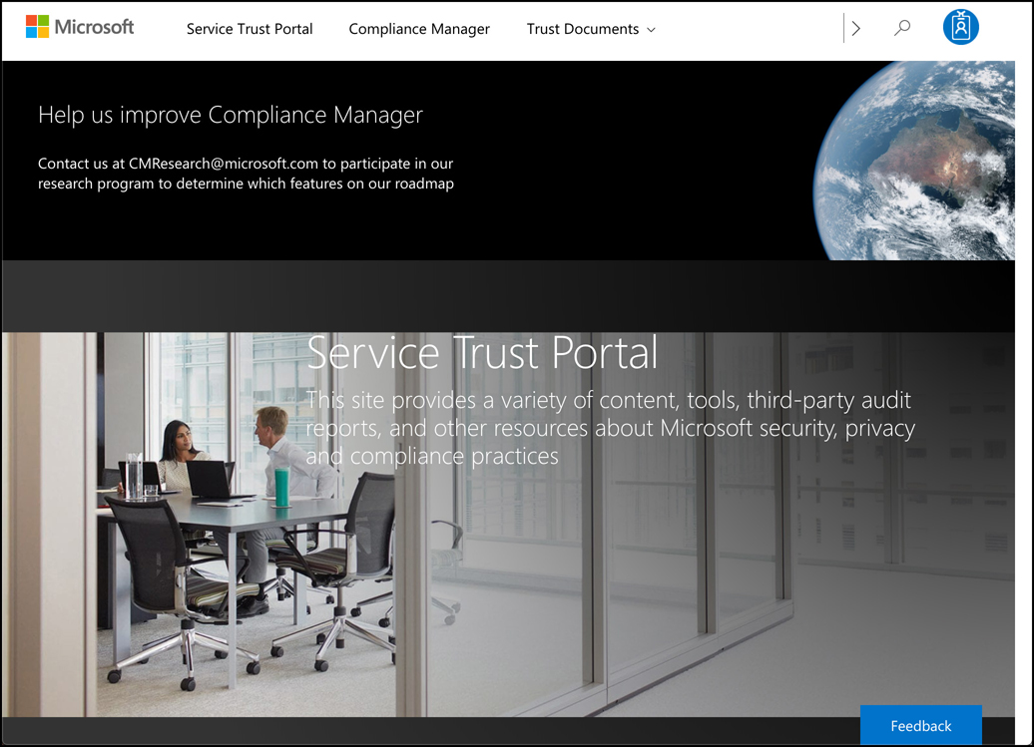
The Service Trust Portal (STP) is a portal that provides access to various compliance tools Microsoft provides for you to track compliance in your applications running on Microsoft’s various platforms. You can access the STP by browsing to: https://aka.ms/STP.

Slide 9
The STP is a launching point for the following resources.
Compliance Manager A tool for managing your regulatory compliance in the cloud.
Audit Reports Comprehensive reports and resources that allow you to see details on how Microsoft maintains compliance.
Data Protection Information Full details on how Microsoft designs its cloud offerings to ensure that customer data is protected.
Privacy Information related to how Microsoft helps you maintain compliance with GDPR.

Slide 10
Agenda
Microsoft Privacy Statement
TRUST CENTER
SERVICE TRUST PORTAL
COMPLIANCE MANAGER
AZURE GOVERNMENT
AZURE GERMANY

Slide 11
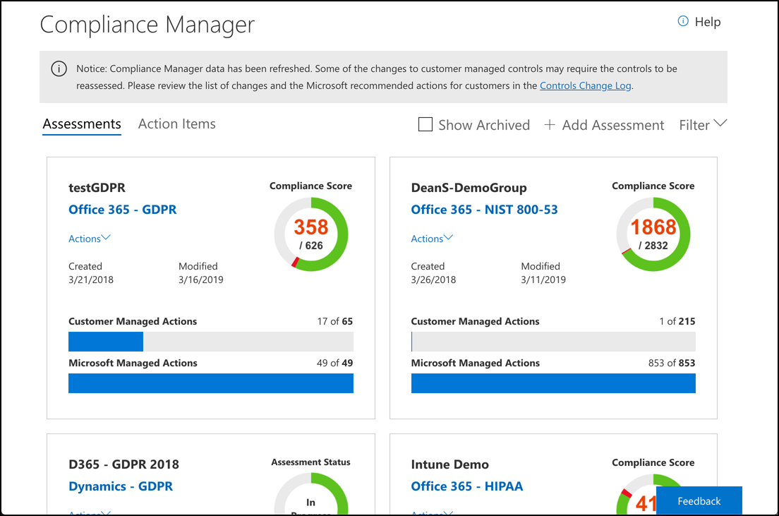
COMPLIANCE MANAGER
Compliance Manager is a tool within the STP that makes it easy to visualize your compliance with industry standards.
Provides details on how you can improve compliance, and for those areas where compliance is Microsoft’s responsibility, it provides full details on how Microsoft maintains compliance.
To access Compliance Manager, click Compliance Manager at the top of the STP page. Compliance Manager allows you to track your compliance with related applications by grouping them into groups that you can give a name of your choice. Each group you create is represented by a tile in Compliance Manager, and you can see at a glance how far you’ve progressed at compliance in each group

Slide 12
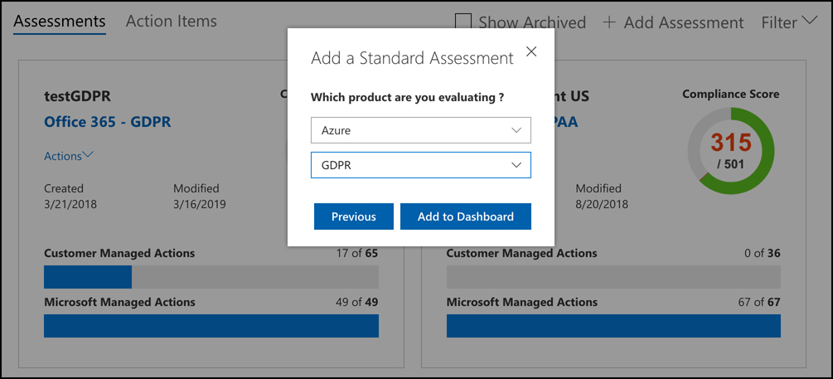
COMPLIANCE MANAGER
You can choose to assess Azure, Office 365, Microsoft Dynamics, and more. You can also choose the standard you want to evaluate against.

Slide 13
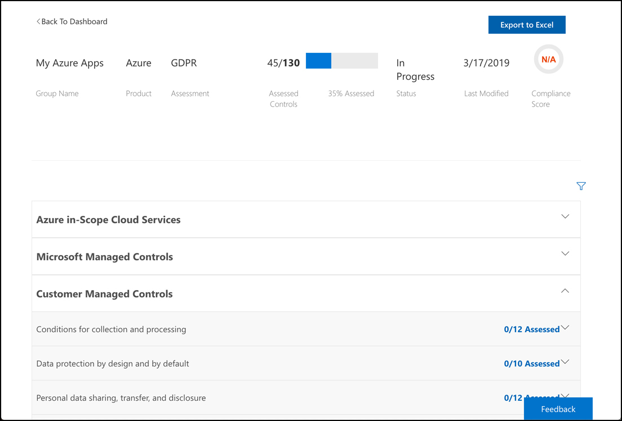
COMPLIANCE MANAGER
Based on the products we’re evaluating, Compliance Manager knows which parts of compliance are Microsoft’s responsibility, and which are the customer’s responsibility. Microsoft’s responsibilities are displayed at the top of the list, and they are already completed. My responsibilities appear in the list as well, and they outline all the requirements we must meet in order to be compliant with GDPR.

Slide 14
COMPLIANCE MANAGER
Based on the products we’re evaluating, Compliance Manager knows which parts of compliance are Microsoft’s responsibility, and which are the customer’s responsibility. Microsoft’s responsibilities are displayed at the top of the list, and they are already completed. My responsibilities appear in the list as well, and they outline all the requirements we must meet in order to be compliant with GDPR.

Slide 15
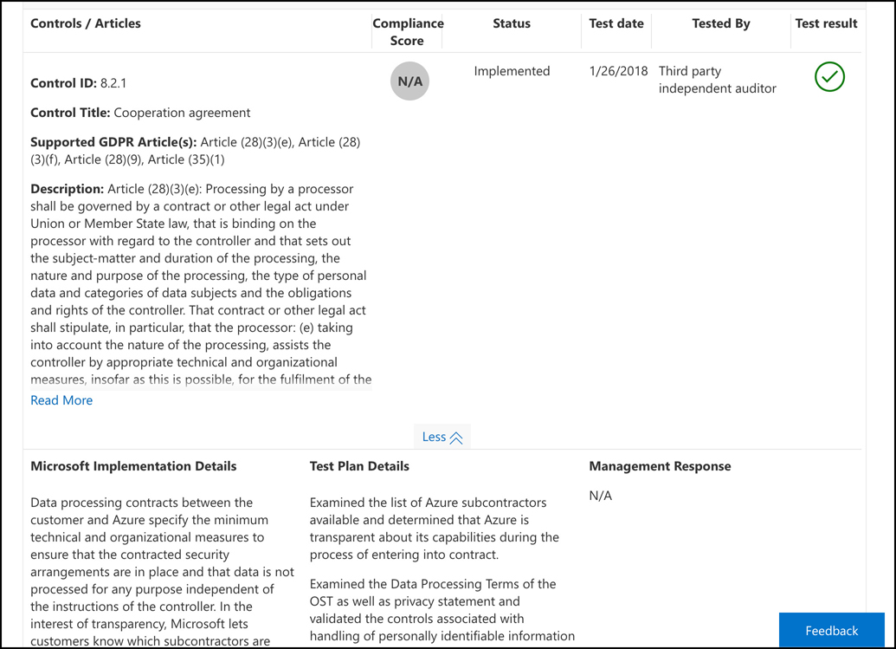
COMPLIANCE MANAGER
If you click on one of the Microsoft controls, you’ll see details on what Microsoft has done to ensure compliance. In the control shown in the figure, you can see how Microsoft complied with specific GDPR articles, when it was tested, and how it was tested.

Slide 16
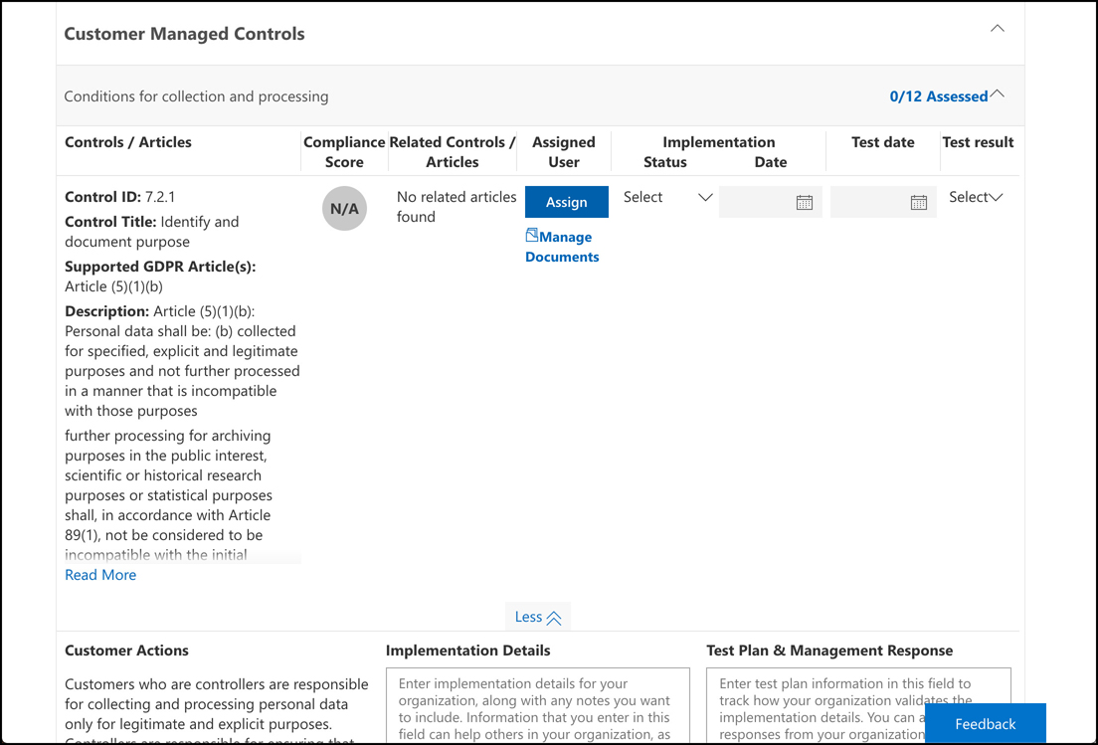
COMPLIANCE MANAGER
If you click on a customer managed control, you can see details on what you need to do to comply. Details are shown regarding what you need to do to comply with GDPR Article (5)(1)(b). You have the option of assigning this task to a specific user if you want to, and you can click on Manage Documents to upload supporting documents to Compliance Manager.
Using this method of assessment, you can always determine if your applications are compliant. The burden of understanding certain standards and regulations is removed because Compliance Manager manages that for you.

Slide 17
Agenda
Microsoft Privacy Statement
TRUST CENTER
SERVICE TRUST PORTAL
COMPLIANCE MANAGER
AZURE GOVERNMENT
AZURE GERMANY

Slide 18
Azure Government
Compliance with GDPR and the other standards mentioned relates to the privacy of an individual’s data. Some US government compliance scenarios require that data stays within the United States of America and that only citizens of the United States have any access to systems used to store that data. Complying with these requirements is impossible with the public cloud, so Microsoft has developed completely isolated Azure data centers that make up the Azure Government cloud.
Azure Government data centers are separate from public data centers. All employees working in Azure Government are screened and are citizens of the US. Even Microsoft employees who provide technical support to Azure Government customers are required to be US citizens.
Because Microsoft also wanted to allow for compliant communication between the Azure Government cloud and on-premises government systems, they also developed dedicated Microsoft ExpressRoute locations that are completely isolated from other Azure networks and that use their own dedicated fiber optic components.

Slide 19
Azure Government
Azure Government isn’t only for federal government agencies. Cities and municipalities also take advantage of Azure Government for compliance. When a customer signs up for Azure Government, Microsoft vets that user to ensure they are representative of a government agency. Only then are they given a subscription to Azure Government.
The Azure Government cloud has all of the same features and services as the public cloud, but there are small differences. For example, the portal for Azure Government is located at https://portal.azure.us instead of https://portal.azure.com. URLs for Azure services also use the .us top-level domain, so if you create an App Service web app in Azure Government, your default domain name is https://webapp.azurewebsites.us. However, outside of that difference, everything else is the same, so developers who have a skill set in cloud development in Azure will find that their skills transfer directly to Azure Government.
The United States Department of Defense has additional compliance requirements called DoD Impact Level 5 Provisional Authorization. Compliance with this relates to controlled unclassified information that requires additional levels of protection. These additional DoD requirements are met by a subset of data centers within Azure Government that are approved for DoD usage.

Slide 20
Agenda
Microsoft Privacy Statement
TRUST CENTER
SERVICE TRUST PORTAL
COMPLIANCE MANAGER
AZURE GOVERNMENT
AZURE GERMANY

Slide 21
Much like Azure Government, Azure Germany is a distinct cloud system that’s designed to meet specific compliance needs. In the case of Azure Germany, those needs relate to the strict requirements imposed by the EU. Azure Germany is available to customers doing business in the EU, the European Free Trade Association, and the UK.
Azure Germany datacenters are physically located in Germany and are operated under strict security measures by a local company named T-Systems International (a subsidiary of Deutsche Telekom) that operates as a data trustee. The data trustee has full control over all data stored in Azure Germany and all of the infrastructure used to house that data. Microsoft is involved in managing only those systems that have no access at all to customer data.

